Slide 1
Sanatorium "Ruska Polyana"

Slide 2
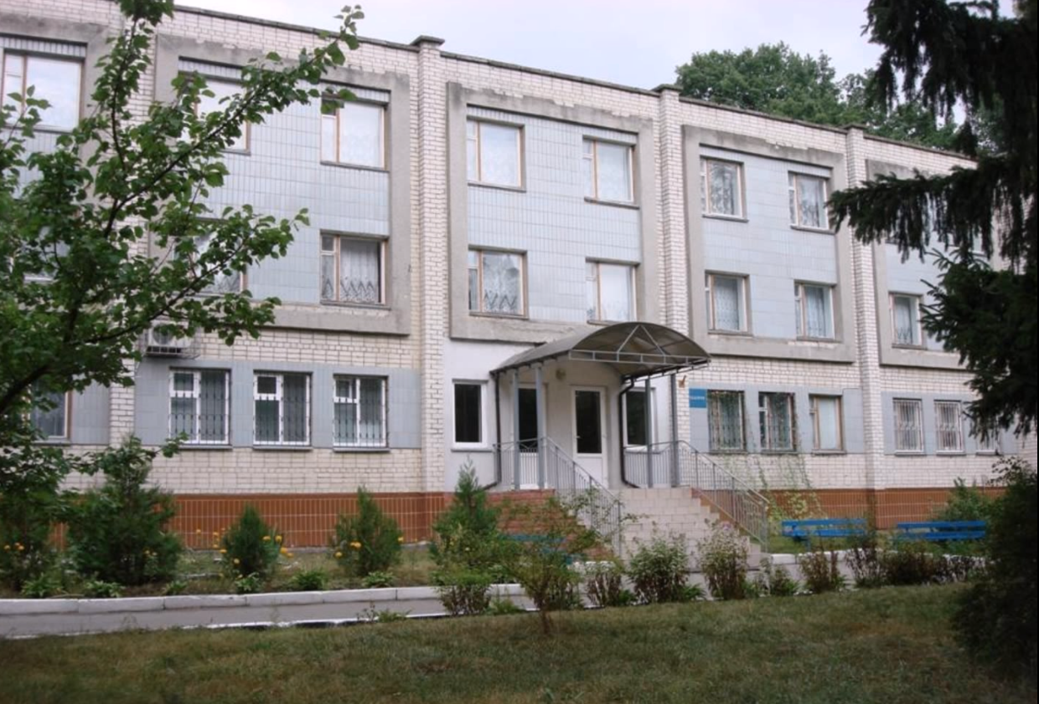
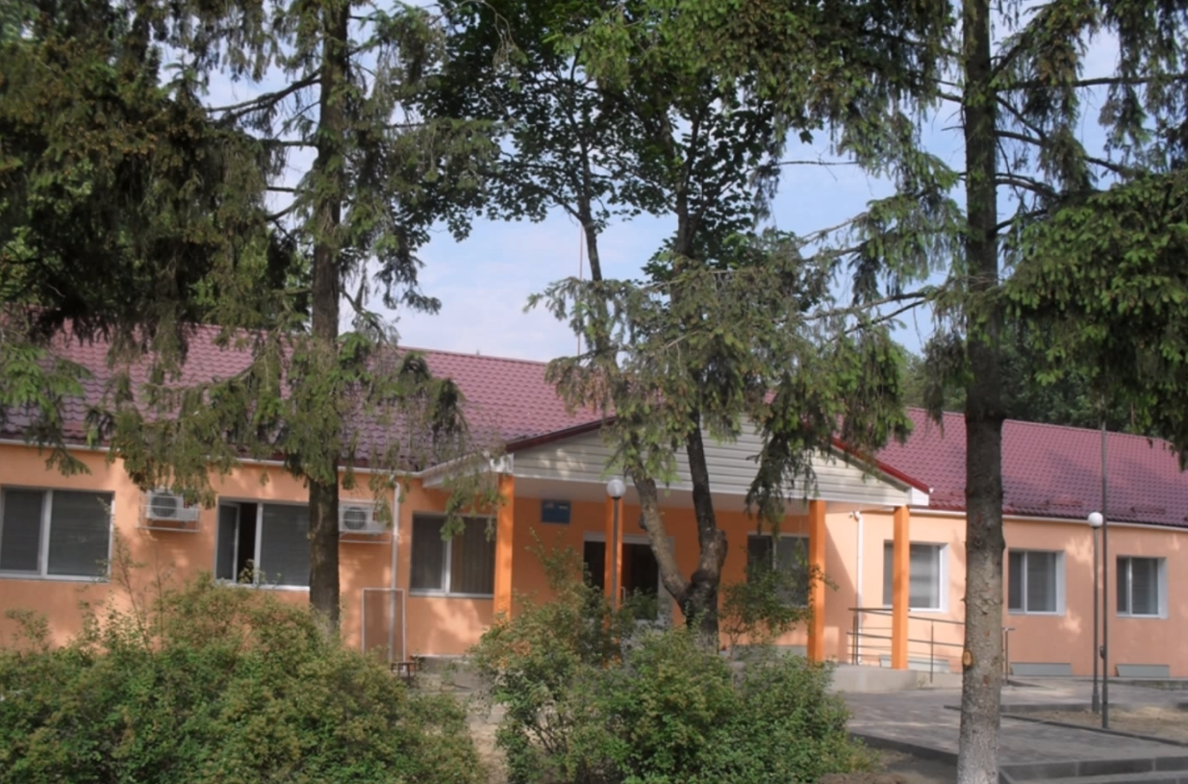
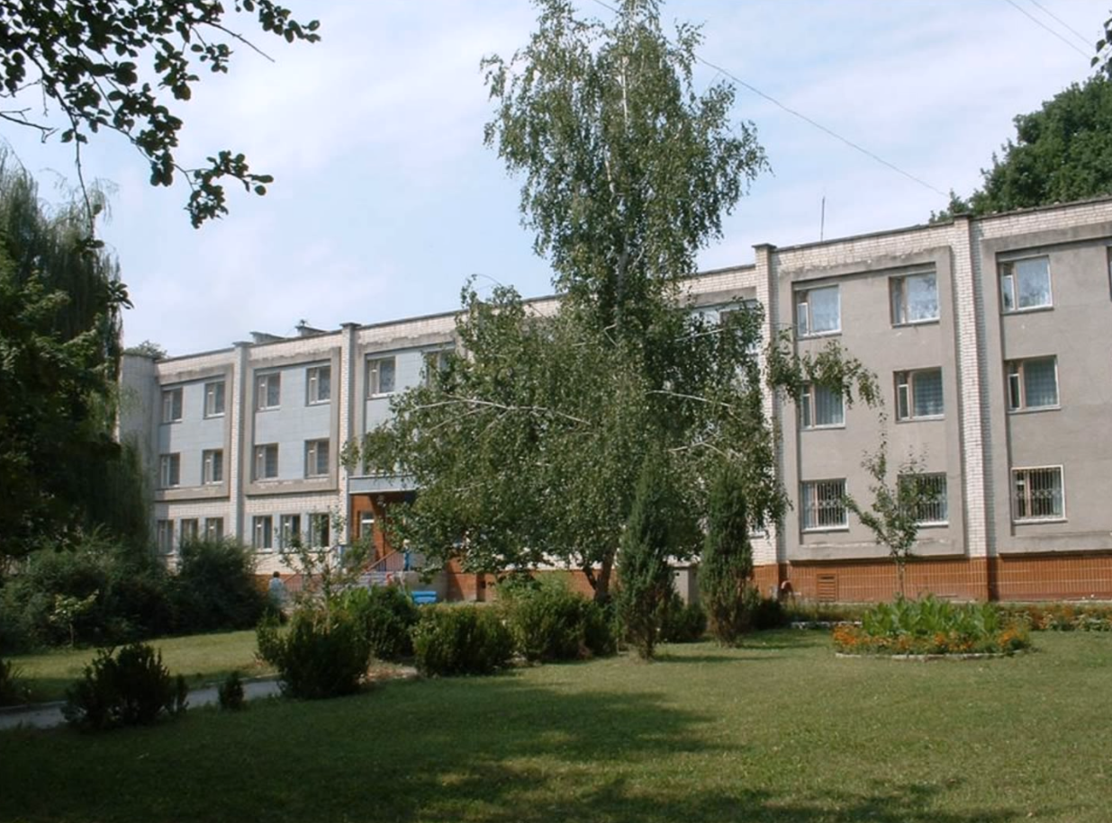
The regional sanatorium for children «Ruska polyana» is a modern medical-prophylactic institution that treats 1500 – 2000 children per year. It is situated on 9 hectares in pine forest reserve. There is a school I-II grades, where children study according to the program of secondary school

Slide 3
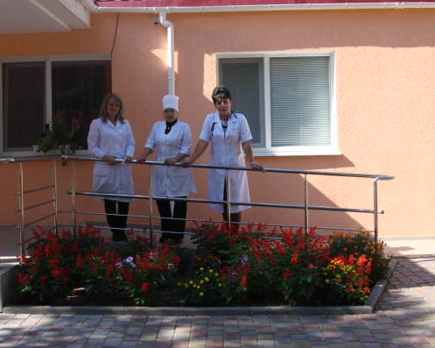
In the laboratory works a laboratory doctor, a laboratory assistant and a nurse.

Slide 4
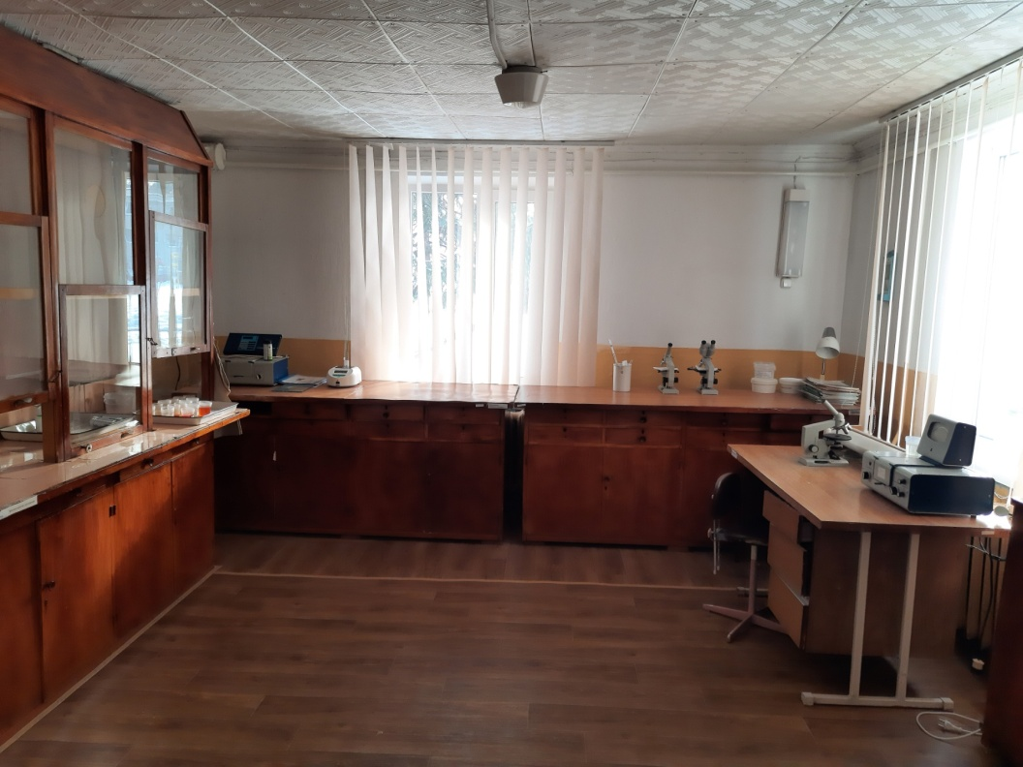
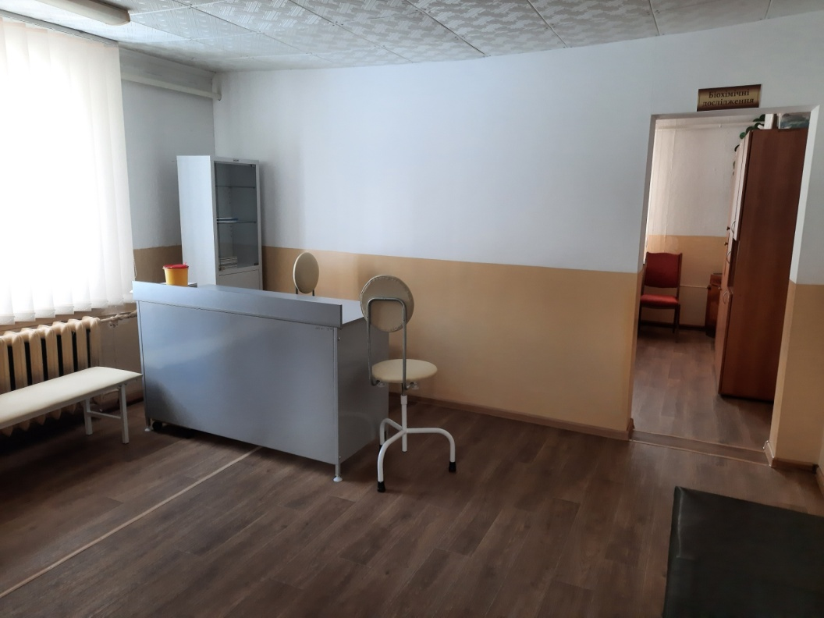
The cabinet for taking biological material
(blood sampling)
Cabinet of general clinical research, performs general urine tests, ketone bodies, bile pigments, urine birirubin, scrapings for enterobiosis, feces for helminth eggs.

Slide 5
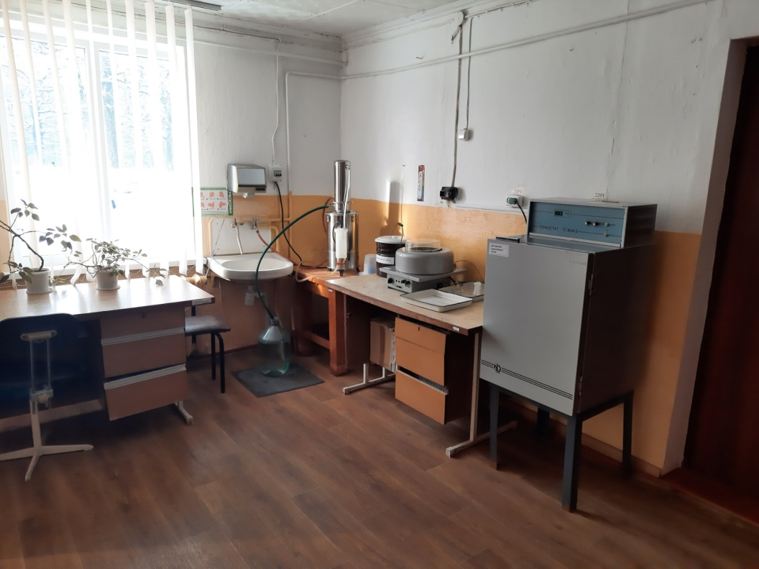
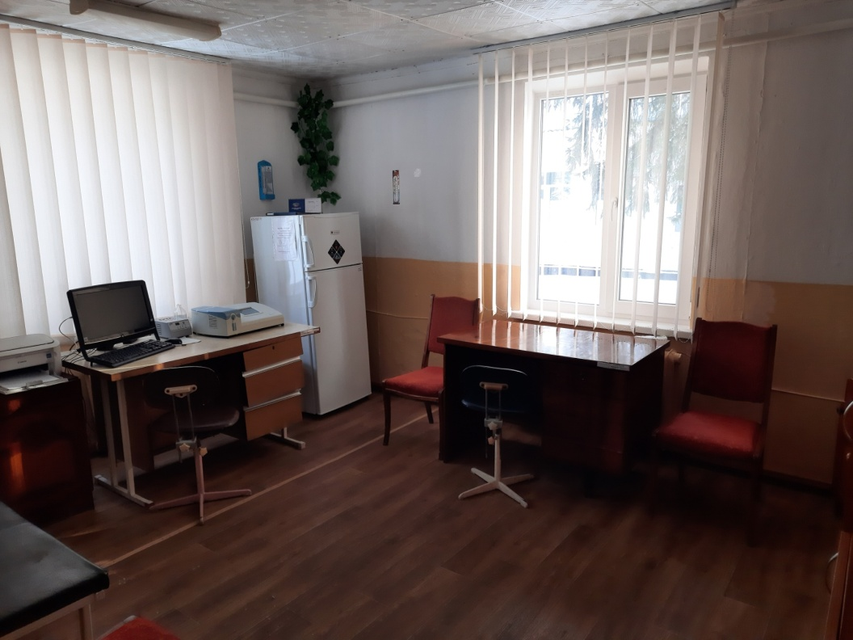
Cabinet of biochemical research, performs biochemical research: Alat, Asat, bilirubin, urea, thymol test, uric acid, creatinine, total protein, α-amylase, CRP and RF factor, blood glucose.
Cabinet of hematological research, performs a general blood test.

Slide 6
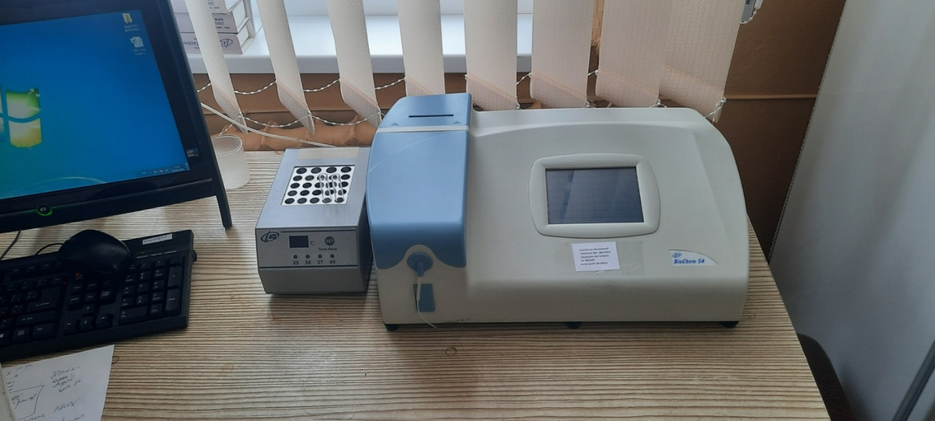
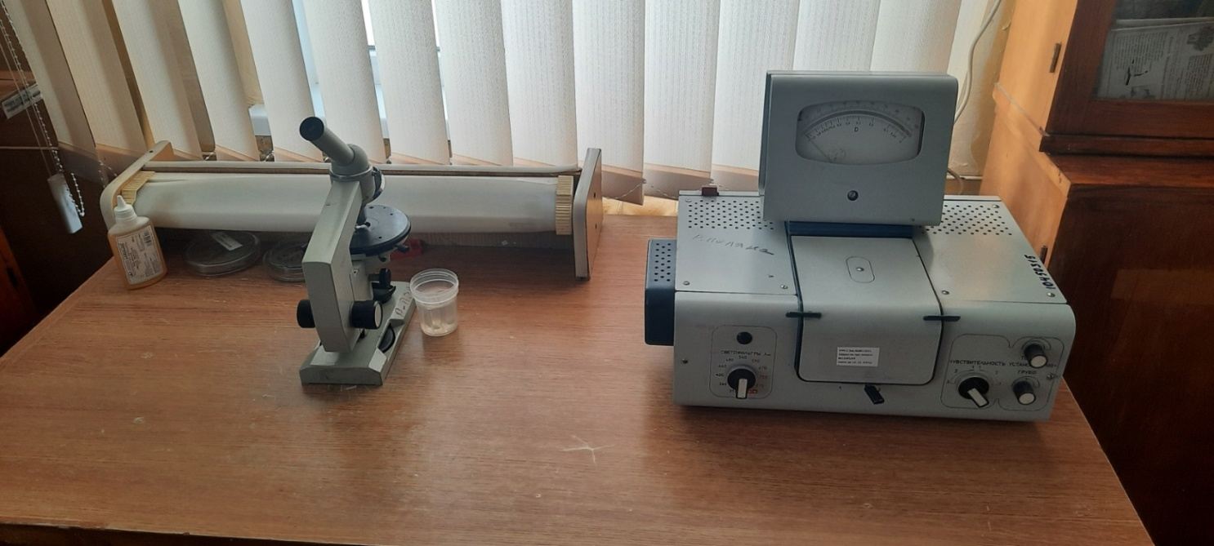
Laboratory equipment

Slide 7
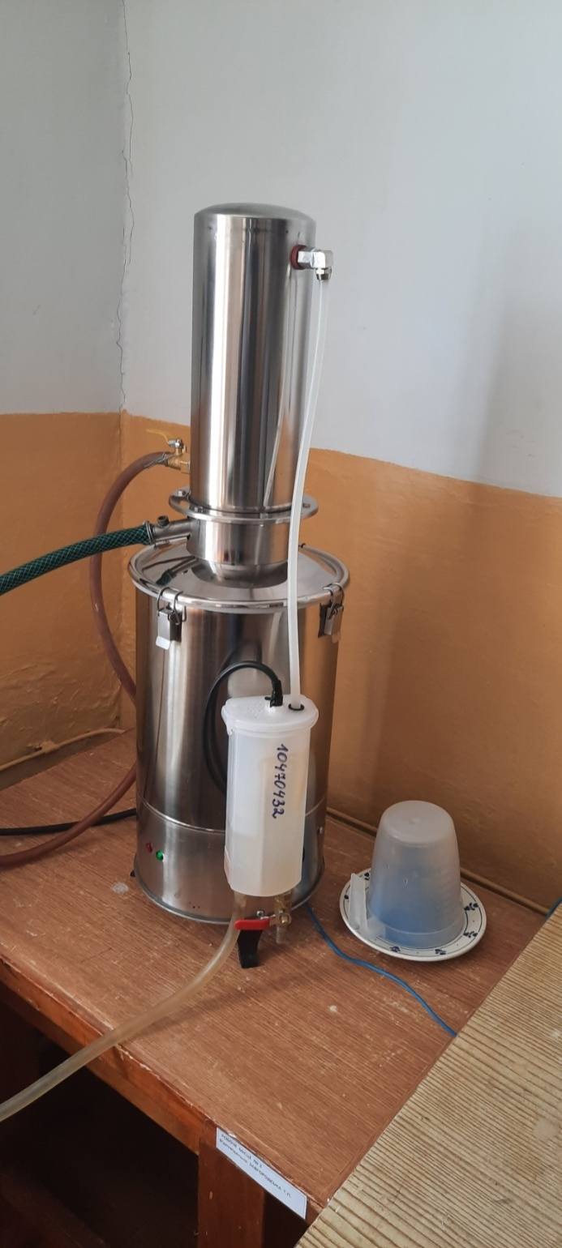
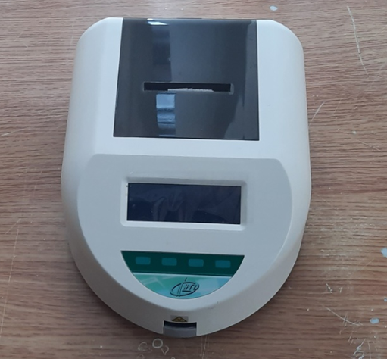
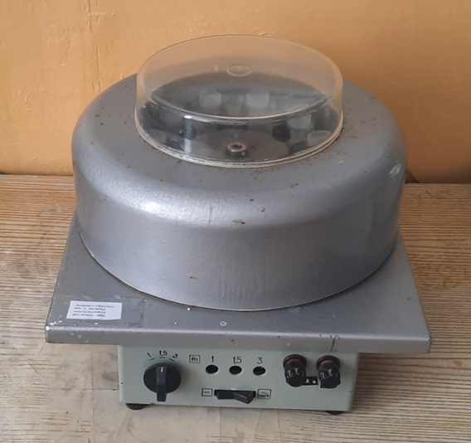

Slide 8
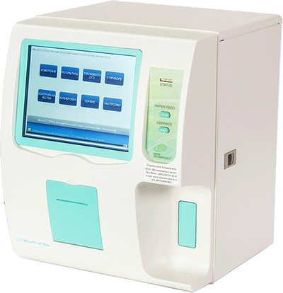
Equipment that must be purchased to upgrade the laboratory
Hematological analyzer Micro CC 20 plus

Slide 9
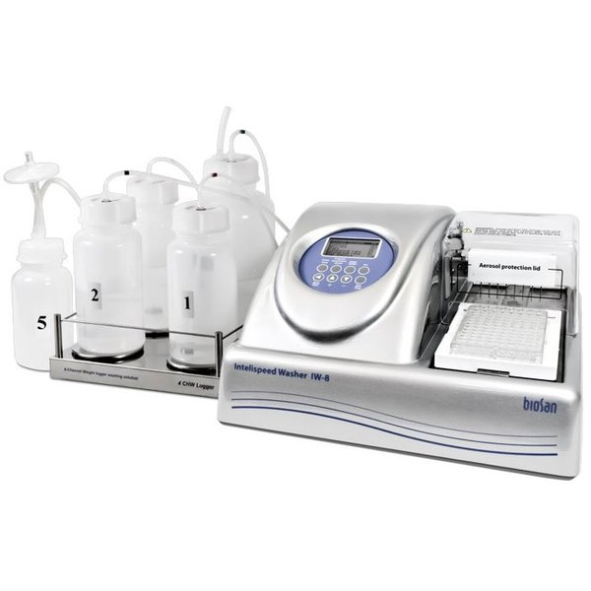
Biosan IW-8 Automatic Biosan tablet washer

Slide 10
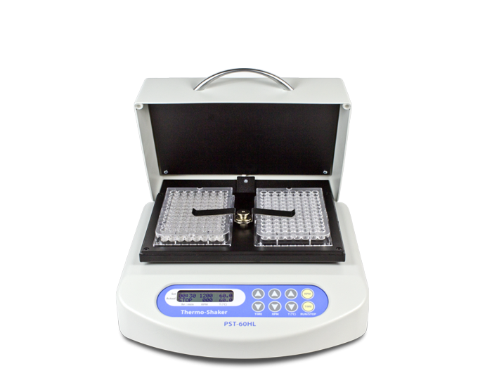
BS-010119-AAI Thermoshaker for PST-60HL tablets

Slide 11
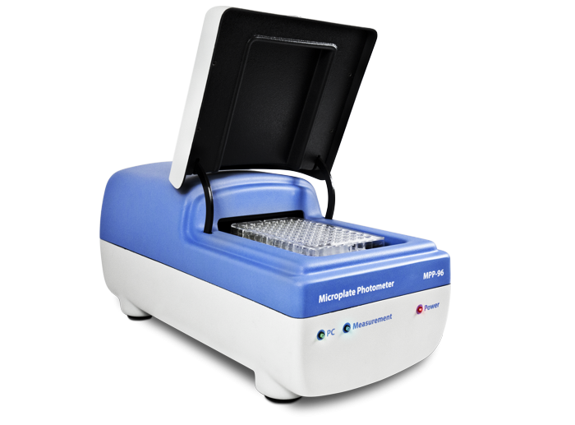
HiPo MPP-96 Photometer for Biosan microplates

Slide 12
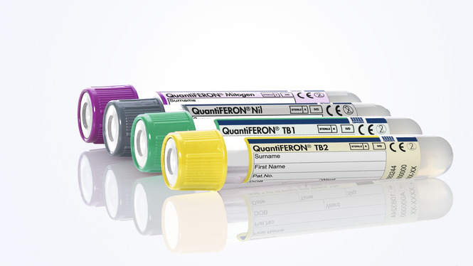
Set of reagents QuantiFERON®-TB Gold Plus (QFT®-Plus) 2 ELISA plates. QIAGEN

Slide 13
Blood collection tubes QuantiFERON®-TB Gold Plus (QFT®-Plus). QIAGEN

Slide 14
Thank you

